Slide 1
Shannon theory and Symmetric Cipher
Vietnam National University Ho Chi Minh City, University of Science
Department of Information Technology
Assoc. Prof. Trần Minh Triết
PhD. Trương Toàn Thịnh

Slide 2
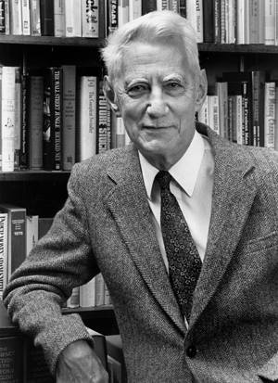
Contents
Introduction - Claude Shannon
Perfect security
Entropy
Combination of crypto-systems
Claude E. Shannon (1916-2001)
http://www.wisdom.weizmann.ac.il/~naor/COURSE/GiladTsur_YossiOren_ShannonSecrecy.ppt

Slide 3
Probability
Let X and Y be two random variables.
Definition:
  p(x) = p(X = x) is a probability of X receiving value x
  p(y) = p(Y = y) is a probability of Y receiving value y
  p(x | y) is a probability of X receiving value x if Y receives value y (conditional probability)
X and Y are independent random variables if only if p(x, y) = p(x) × p(y) for any value x of X and value y of Y

Slide 4

Probability
Example: consider tossing 2 dices
  We have result-space Ω = {(1,1),(1,2),(1,3),(1,4),(1,5),(1,6),
  (2,1),(2,2),(2,3),(2,4),(2,5),(2,6),
  (3,1),(3,2),(3,3),(3,4),(3,5),(3,6),
  (4,1),(4,2),(4,3),(4,4),(4,5),(4,6),
  (5,1),(5,2),(5,3),(5,4),(5,5),(5,6),
  (6,1),(6,2),(6,3),(6,4),(6,5),(6,6)}
  |Ω| = 36 elements, for w ∈ Ω
  Let X (based on Ω) be sum of two dices => X(w) ∈ {2, 3, 4, 5, 6, 7, 8, 9, 10, 11, 12}
Notation of mapping X: Ω → ℝ

Slide 5

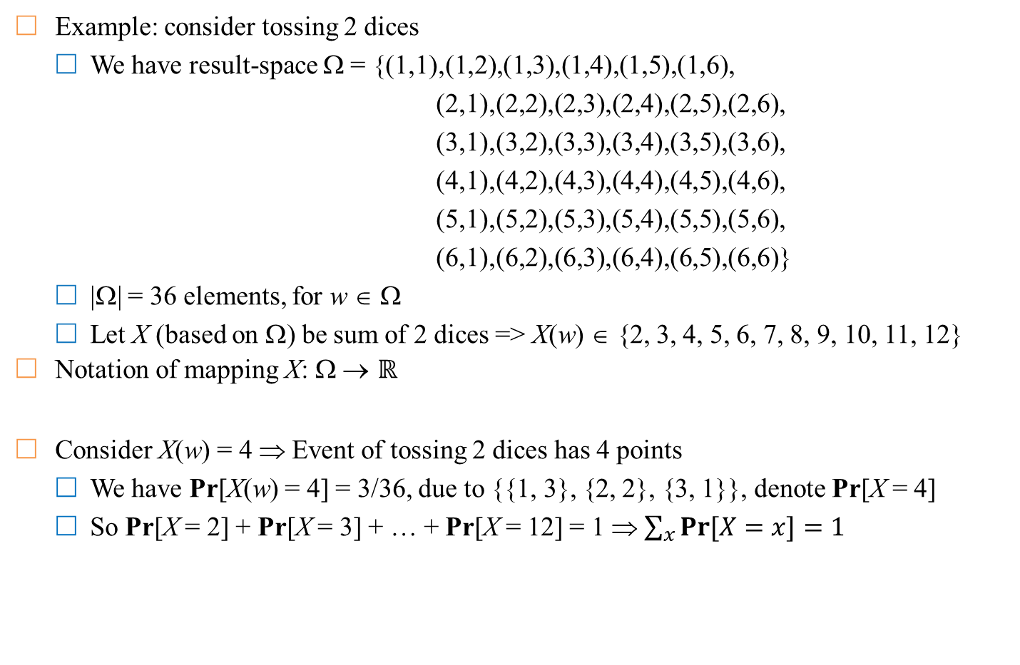
Probability
Example: consider tossing 2 dices
  We have result-space Ω = {(1,1),(1,2),(1,3),(1,4),(1,5),(1,6),
  (2,1),(2,2),(2,3),(2,4),(2,5),(2,6),
  (3,1),(3,2),(3,3),(3,4),(3,5),(3,6),
  (4,1),(4,2),(4,3),(4,4),(4,5),(4,6),
  (5,1),(5,2),(5,3),(5,4),(5,5),(5,6),
  (6,1),(6,2),(6,3),(6,4),(6,5),(6,6)}
  |Ω| = 36 elements, for w ∈ Ω
  Let X (based on Ω) be sum of 2 dices => X(w) ∈ {2, 3, 4, 5, 6, 7, 8, 9, 10, 11, 12}
Notation of mapping X: Ω → ℝ
Consider X(w) = 4 ⇒ Event of tossing 2 dices has 4 points
  We have Pr[X(w) = 4] = 3/36, due to {{1, 3}, {2, 2}, {3, 1}}, denote Pr[X = 4]
  So Pr[X = 2] + Pr[X = 3] + … + Pr[X = 12] = 1 ⇒ $\sum_{x}{Pr⁡[X=x]}=1$

Slide 6

Probability
Example: consider tossing 2 dices
  We have result-space Ω = {(1,1),(1,2),(1,3),(1,4),(1,5),(1,6),
  (2,1),(2,2),(2,3),(2,4),(2,5),(2,6),
  (3,1),(3,2),(3,3),(3,4),(3,5),(3,6),
  (4,1),(4,2),(4,3),(4,4),(4,5),(4,6),
  (5,1),(5,2),(5,3),(5,4),(5,5),(5,6),
  (6,1),(6,2),(6,3),(6,4),(6,5),(6,6)}
  |Ω| = 36 elements, for w ∈ Ω
  Let Y (based on Ω) be the result of tossing 2 dices with the same point => Y(w) ∈ {“2 same points”, “2 different points”}
  Should change “2 same points” to 1, & “2 different points” to 0 => Y(w) ∈ {0, 1}
Notation of mapping Y: Ω → ℝ

Slide 7

Probability
Example: consider tossing 2 dices
  We have result-space Ω = {(1,1),(1,2),(1,3),(1,4),(1,5),(1,6),
  (2,1),(2,2),(2,3),(2,4),(2,5),(2,6),
  (3,1),(3,2),(3,3),(3,4),(3,5),(3,6),
  (4,1),(4,2),(4,3),(4,4),(4,5),(4,6),
  (5,1),(5,2),(5,3),(5,4),(5,5),(5,6),
  (6,1),(6,2),(6,3),(6,4),(6,5),(6,6)}
  |Ω| = 36 elements, for w ∈ Ω
  Let Y (based on Ω) be the result of tossing 2 dices with the same point => Y(w) ∈ {“2 same points”, “2 different points”}
  Should change “2 same points” to 1, & “2 different points” to 0 => Y(w) ∈ {0, 1}
Notation of mapping Y: Ω → ℝ
Let Y(w) = 1 => Event of tossing 2 dices with the same point
  Pr[Y(w) = 1] = 6/36, due to 6 cases {{1, 1}, …, {6, 6}}
  So Pr[Y = 1] + Pr[Y = 0] = 1

Slide 8
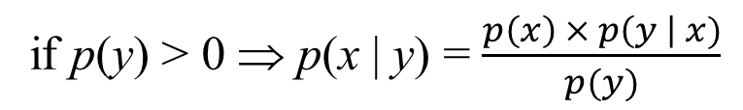
Bayes theorem
Let X and Y be two random variables
Bayes theorem
Corollary: X and Y are two independent ones ⇔ p(x | y) = p(x), ∀x, y
p(x, y) = p(x | y) × p(y) = p(y | x)× p(x)
Apriori
if p(y) > 0 ⇒ p(x | y) = $\frac{p\left(x\right) × p\left(y \right| x)}{p(y)}$
Aposteriori

Slide 9
Bayes theorem
Reconsider: example of tossing 2 dices
  We have result-space Ω = {(1,1),(1,2),(1,3),(1,4),(1,5),(1,6),
  …
  (6,1),(6,2),(6,3),(6,4),(6,5),(6,6)}
  |Ω| = 36 elements, for w ∈ Ω
  X: Sum of points of 2 dices => X(w) ∈ {2, 3, 4, …, 12}
  Y: 2 dices with the same point => Y(w) ∈ {0, 1}
Compute Pr[Y = 1|X = 4] (Probability of 4-point with 2 same faces)
  Pr[X = 4] = 3/36 => Pr[Y = 1|X = 4] = 1/3 due to {(1, 3), (2, 2), (3, 1)}
Compute Pr[X = 4|Y = 1] (Probability of 4-point with 2 same faces)
  Pr[Y = 1] = 6/36 => Pr[X = 4|Y = 1] = 1/6 due to {(1, 1), (2, 2), …, (6, 6)}
So Pr[Y = 1|X = 4] × Pr[X = 4] = Pr[X = 4|Y = 1] × Pr[Y = 1]

Slide 10
Context of cryptography
Some probabilistic notation for crypto-context
  p_{P} (x) : Probability of appearing plaintext x
  p_{K}(k) : Probability of choosing key k
  p_{C}(y) : Probability of ciphertext receiving value y
Note:
  Notations p_{P}, p_{K} and p_{C} are the probabilities for each distinct set
  It can be assumed that the key value k and the plaintext x are independent events
From the probability distribution of plaintext and key on the set P and K, we can determine the conditional probability distribution of plaintext ???

Slide 11
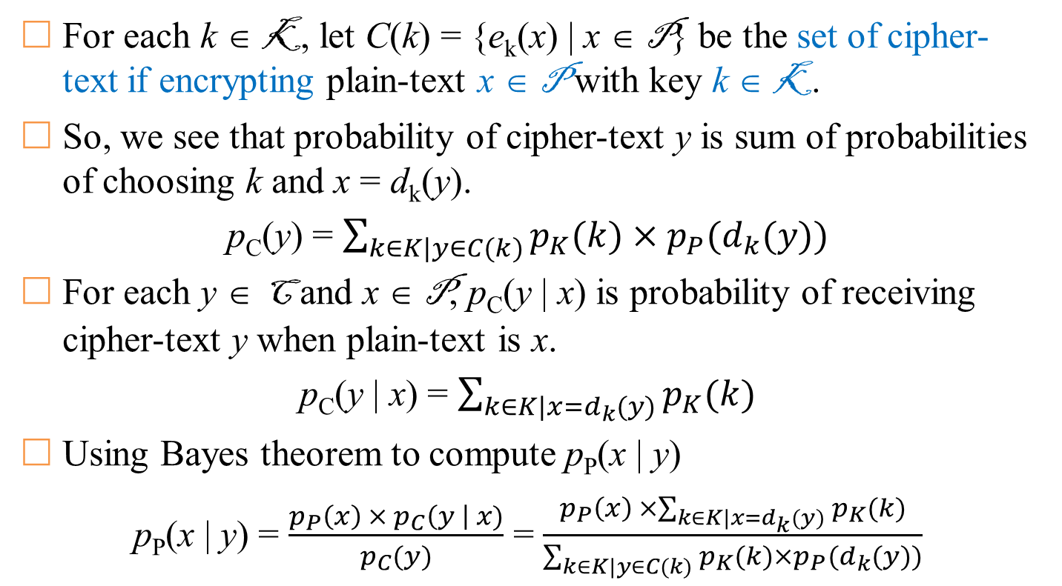
Context of cryptography
For each k ∈ K, let C(k) = {e_{k}(x) | x ∈ P} be the set of cipher-text if encrypting plain-text x ∈ P with key k ∈ K.
So, we see that probability of cipher-text y is sum of probabilities of choosing k and x = d_{k}(y).
p_{C}(y) = $\sum_{k∈K|y∈C(k)}{p_{K}(k)×p_{P}(d_{k}(y))}$
For each y ∈ C and x ∈ P, p_{C}(y | x) is probability of receiving cipher-text y when plain-text is x.
p_{C}(y | x) = $\sum_{k∈K|x=d_{k}(y)}{p_{K}(k)}$
Using Bayes theorem to compute p_{P}(x | y)
p_{P}(x | y) = $\frac{p_{P}\left(x\right) × p_{C}\left(y \right| x)}{p_{C}(y)}$ = $\frac{p_{P}\left(x\right) ×\sum_{k∈K|x=d_{k}(y)}{p_{K}(k)}}{\sum_{k∈K|y∈C(k)}{p_{K}(k)×p_{P}(d_{k}(y))}}$
Thực chất là xác suất chọn các khóa k

Slide 12
Example
Let P = {a, b} with p_{P}(a) = ¼, p_{P}(b) = ¾
Let K = {k₁, k₂, k₃} with p_{K}(k₁) = ½, p_{K}(k₂) = p_{K}(k₃) = ¼
Let C = {1, 2, 3, 4}
Let E be a set of encryption rules
  e_{k1}(a) = 1, e_{k1}(b) = 2
  e_{k2}(a) = 2, e_{k2}(b) = 3
  e_{k3}(a) = 3, e_{k3}(b) = 4
Let D be a set of decryption rules
  d_{k1}(1) = a, d_{k1}(2) = b
  d_{k2}(2) = a, d_{k2}(3) = b
  d_{k3}(3) = a, d_{k3}(4) = b
 | a | b
k₁ | 1 | 2
k₂ | 2 | 3
k₃ | 3 | 4
 | 1 | 2 | 3 | 4
k₁ | a | b
k₂ |  | a | b
k₃ |  |  | a | b

Slide 13
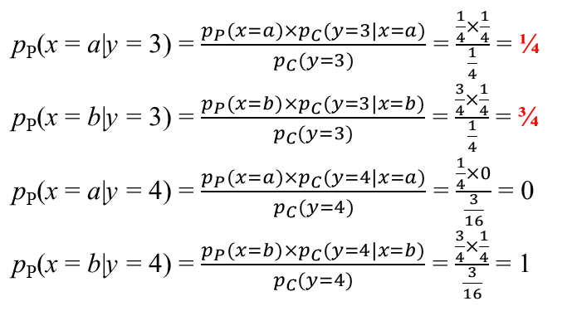
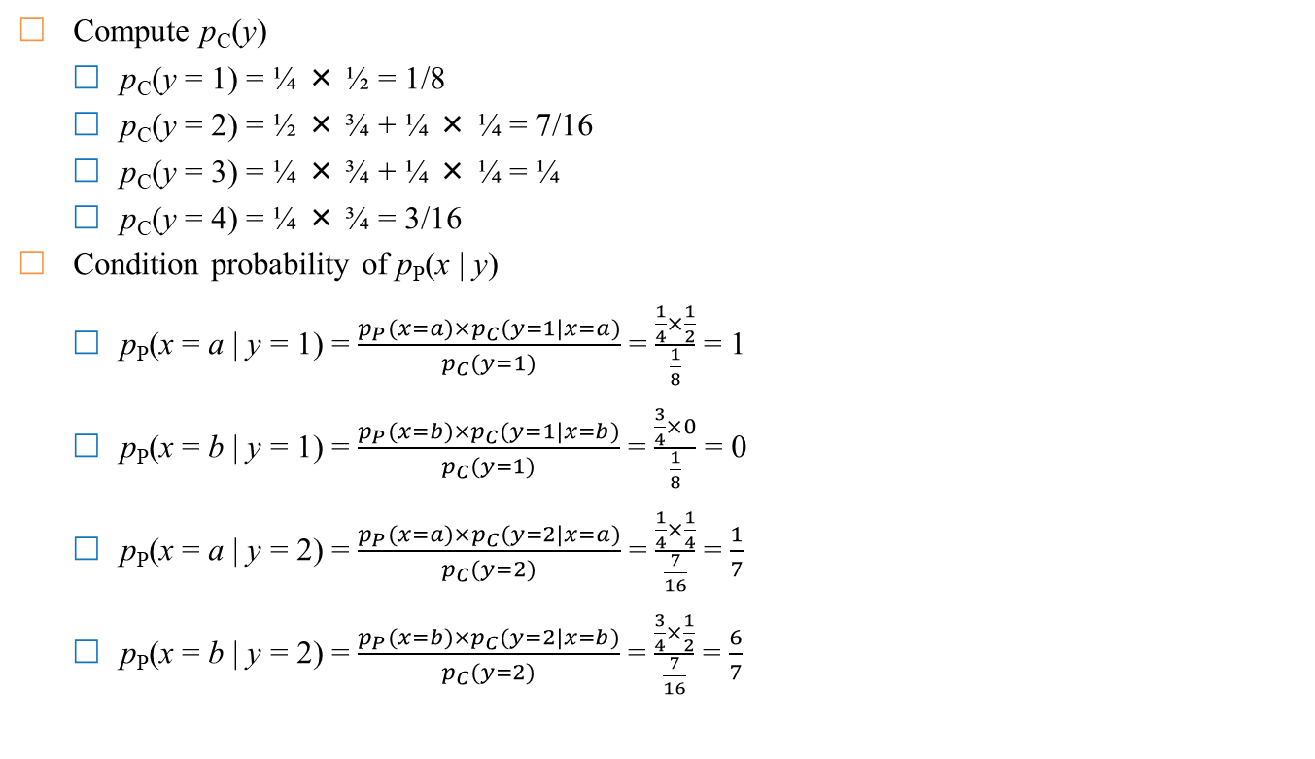
Example
Compute p_{C}(y)
  p_{C}(y = 1) = ¼ × ½ = 1/8
  p_{C}(y = 2) = ½ × ¾ + ¼ × ¼ = 7/16
  p_{C}(y = 3) = ¼ × ¾ + ¼ × ¼ = ¼
  p_{C}(y = 4) = ¼ × ¾ = 3/16
Condition probability of p_{P}(x | y)
  p_{P}(x = a | y = 1) = $\frac{p_{P}(x=a)×p_{C}(y=1|x=a)}{p_{C}(y=1)}$ = $\frac{\frac{1}{4}×\frac{1}{2}}{\frac{1}{8}}$ = 1
  p_{P}(x = b | y = 1) = $\frac{p_{P}(x=b)×p_{C}(y=1|x=b)}{p_{C}(y=1)}$ = $\frac{\frac{3}{4}×0}{\frac{1}{8}}$ = 0
  p_{P}(x = a | y = 2) = $\frac{p_{P}(x=a)×p_{C}(y=2|x=a)}{p_{C}(y=2)}$ = $\frac{\frac{1}{4}×\frac{1}{4}}{\frac{7}{16}}$ = $\frac{1}{7}$
  p_{P}(x = b | y = 2) = $\frac{p_{P}(x=b)×p_{C}(y=2|x=b)}{p_{C}(y=2)}$ = $\frac{\frac{3}{4}×\frac{1}{2}}{\frac{7}{16}}$ = $\frac{6}{7}$
 | a p_{P} = ¼ | b p_{P} = ¾
k₁ (p_{K} = ½) | 1 | 2
k₂ (p_{K} = ¼) | 2 | 3
k₃ (p_{K} = ¼) | 3 | 4
1
3
2
4

Slide 14
Perfect security
Perfectly secure?
Significance: The attacker gets nothing from the ciphertext
∀x ∈ P, ∀k ∈ K, p_{P}(x | c) = p_{P}(x), p_{K}(k | c) = p_{K}(k)
Evaluate Shift-cipher
  Assume 26 keys in Shift-cipher are randomly chosen with uniform probability (1/26)
  With set of plaintext having any probability distribution, Shift-cipher achieve perfect security???
  Let P = C = K = Z₂₆ = {0, 1, 2, …, 25}
  e_{k}(x) = (x + k) mod 26 and d_{k}(y) = (y – k) mod 26

Slide 15
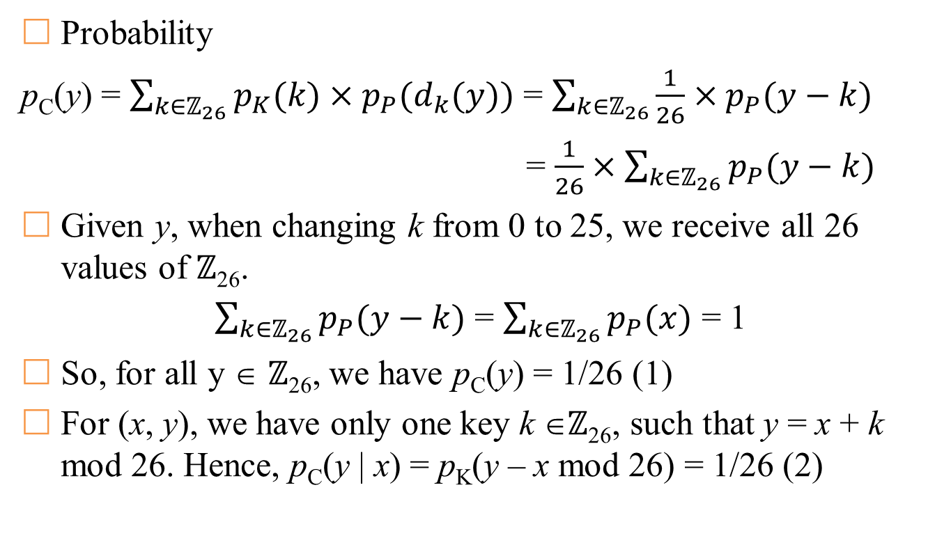
Perfect security (on Shift Cipher)
Probability
p_{C}(y) = $\sum_{k∈ℤ_{26}}{p_{K}(k)×p_{P}(d_{k}(y))}$ = $\sum_{k∈ℤ_{26}}{\frac{1}{26}×p_{P}(y−k)}$
= $\frac{1}{26}×\sum_{k∈ℤ_{26}}{p_{P}(y−k)}$
Given y, when changing k from 0 to 25, we receive all 26 values of ℤ₂₆.
$\sum_{k∈ℤ_{26}}{p_{P}(y−k)}$ = $\sum_{k∈ℤ_{26}}{p_{P}(x)}$ = 1
So, for all y ∈ ℤ₂₆, we have p_{C}(y) = 1/26 (1)
For (x, y), we have only one key k ∈ℤ₂₆, such that y = x + k mod 26. Hence, p_{C}(y | x) = p_{K}(y – x mod 26) = 1/26 (2)

Slide 16
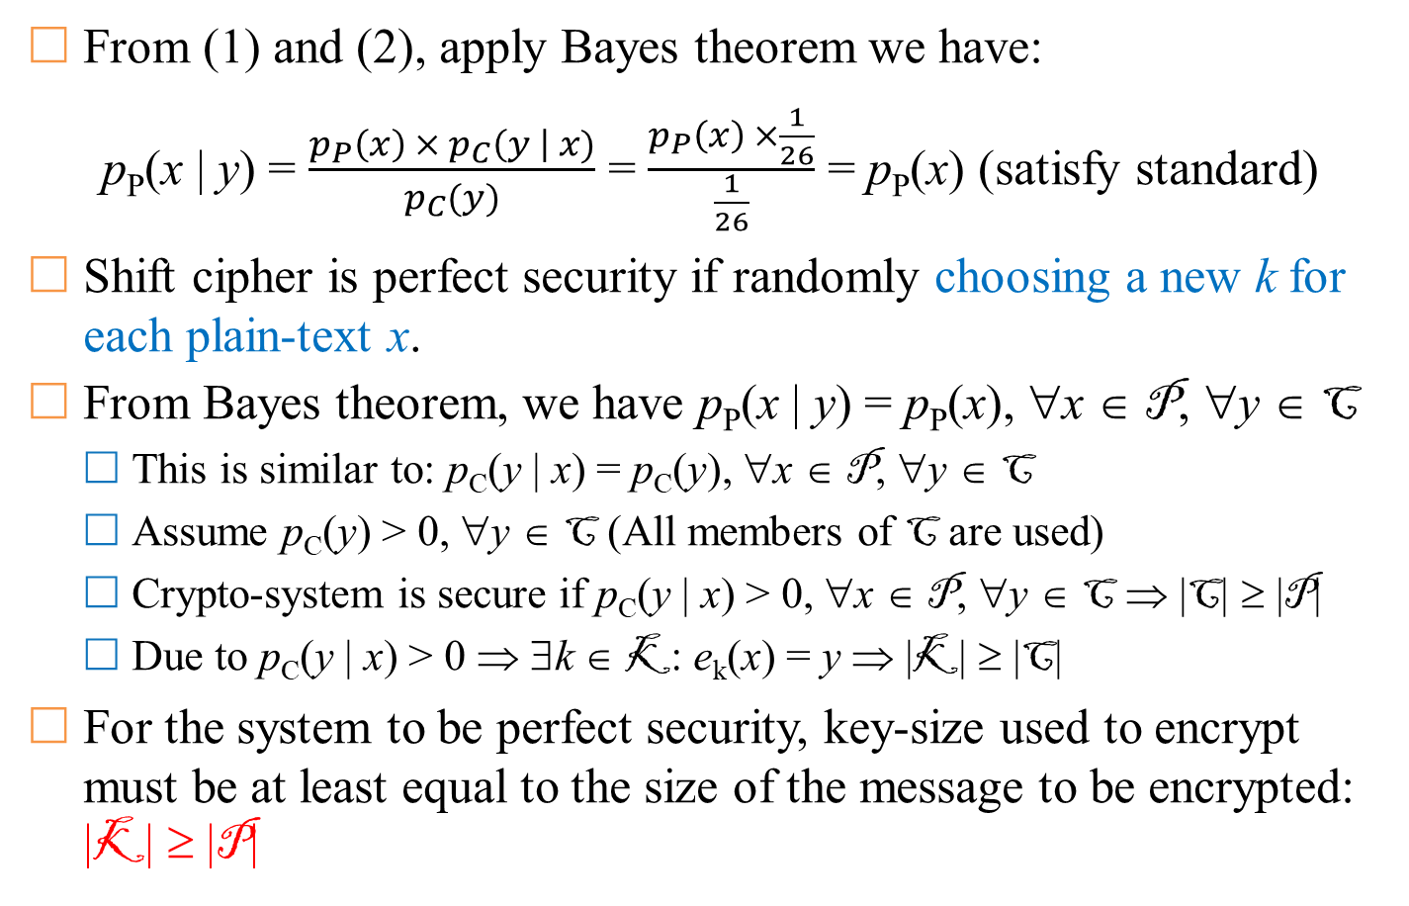
Perfect security (on Shift Cipher)
From (1) and (2), apply Bayes theorem we have:
p_{P}(x | y) = $\frac{p_{P}\left(x\right) × p_{C}\left(y \right| x)}{p_{C}(y)}$ = $\frac{p_{P}\left(x\right) ×\frac{1}{26}}{\frac{1}{26}}$ = p_{P}(x) (satisfy standard)
Shift cipher is perfect security if randomly choosing a new k for each plain-text x.
From Bayes theorem, we have p_{P}(x | y) = p_{P}(x), ∀x ∈ P, ∀y ∈ C
  This is similar to: p_{C}(y | x) = p_{C}(y), ∀x ∈ P, ∀y ∈ C
  Assume p_{C}(y) > 0, ∀y ∈ C (All members of C are used)
  Crypto-system is secure if p_{C}(y | x) > 0, ∀x ∈ P, ∀y ∈ C ⇒ |C| ≥ |P|
  Due to p_{C}(y | x) > 0 ⇒ ∃k ∈ K: e_{k}(x) = y ⇒ |K| ≥ |C|
For the system to be perfect security, key-size used to encrypt must be at least equal to the size of the message to be encrypted: |K| ≥ |P|

Slide 17
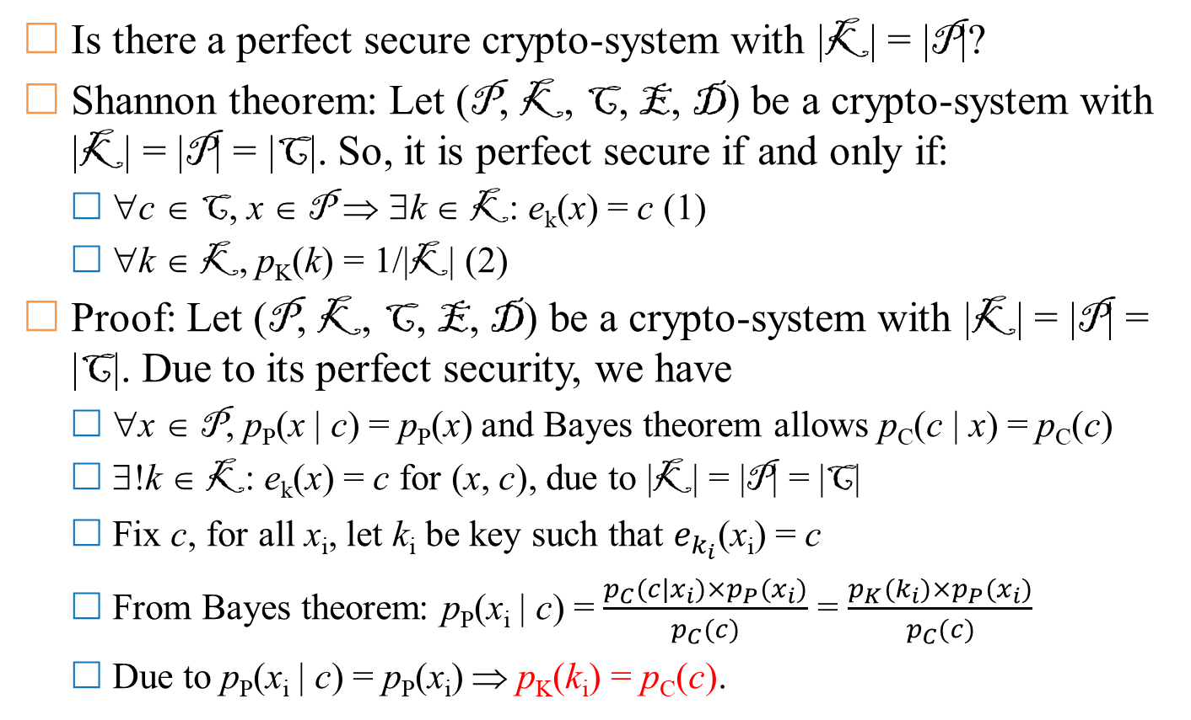
Vernam Cipher
Is there a perfect secure crypto-system with |K| = |P|?
Shannon theorem: Let (P, K, C, E, D) be a crypto-system with |K| = |P| = |C|. So, it is perfect secure if and only if:
  ∀c ∈ C, x ∈ P ⇒ ∃k ∈ K: e_{k}(x) = c (1)
  ∀k ∈ K, p_{K}(k) = 1/|K| (2)
Proof: Let (P, K, C, E, D) be a crypto-system with |K| = |P| = |C|. Due to its perfect security, we have
  ∀x ∈ P, p_{P}(x | c) = p_{P}(x) and Bayes theorem allows p_{C}(c | x) = p_{C}(c)
  ∃!k ∈ K: e_{k}(x) = c for (x, c), due to |K| = |P| = |C|
  Fix c, for all x_{i}, let k_{i} be key such that $e_{k_{i}}$(x_{i}) = c
  From Bayes theorem: p_{P}(x_{i} | c) = $\frac{p_{C}(c|x_{i})×p_{P}(x_{i})}{p_{C}(c)}$ = $\frac{p_{K}(k_{i})×p_{P}(x_{i})}{p_{C}(c)}$
  Due to p_{P}(x_{i} | c) = p_{P}(x_{i}) ⇒ p_{K}(k_{i}) = p_{C}(c).

Slide 18
Vernam Cipher
Gilbert Vernam (Bell Labs) proposed in 1919
  A key is a “long enough” random sequence of values. So, C = P ⊕ K
  This method is proven to be perfect security
  Limitation: the key is too long and cannot be reused
  Advantage: simple
Description:
  Let integer n ≥ 1, and P = C = K = (ℤ₂)^{n}. For each k ∈ (ℤ₂)^{n}, we let:
    e_{k}(x) = (x₁ + k₁, …, x_{n} + k_{n}) mod 2, where x = (x₁, …, x_{n}) and k = (k₁, …, k_{n}).
    d_{k}(y) = (y₁ + k₁, …, y_{n} + k_{n}) mod 2, where y = (y₁, …, y_{n})
Note: operator (+ mod 2) is ⊕-bit

Slide 19
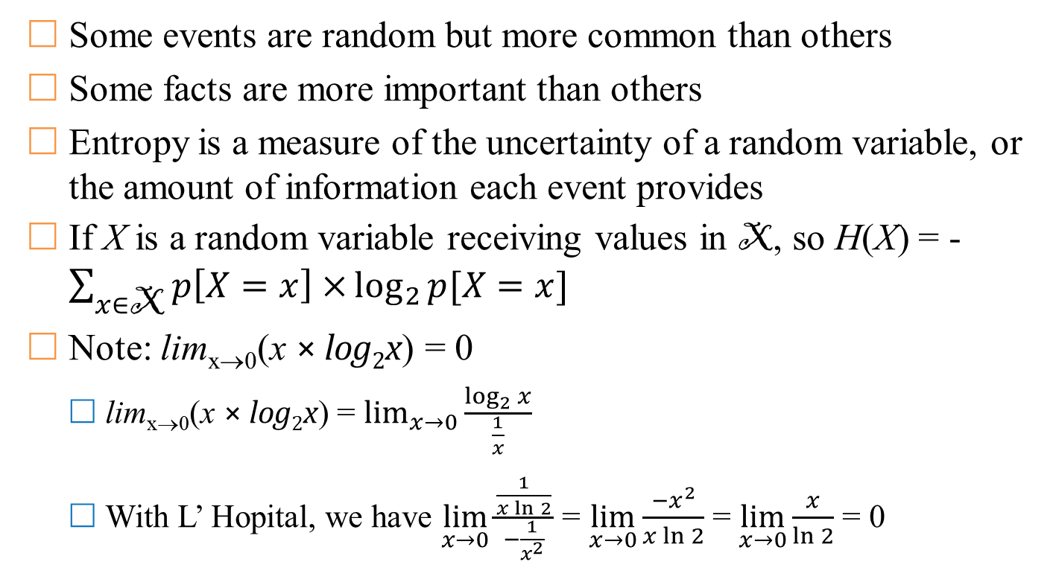
Informatic theory
Some events are random but more common than others
Some facts are more important than others
Entropy is a measure of the uncertainty of a random variable, or the amount of information each event provides
If X is a random variable receiving values in X, so H(X) = -$\sum_{x∈\text{X}}{p\left[X=x\right]×}\log_{2}{p[X=x]}$
Note: lim_{x→0}(x × log₂x) = 0
  lim_{x→0}(x × log₂x) = $\lim_{x→0}{\frac{\log_{2}{x}}{\frac{1}{x}}}$
  With L’ Hopital, we have $\lim_{x→0}{\frac{\frac{1}{x\ln{2}}}{−\frac{1}{x^{2}}}}$ = $\lim_{x→0}{\frac{{−x}^{2}}{x\ln{2}}}$ = $\lim_{x→0}{\frac{x}{\ln{2}}}$ = 0

Slide 20
Entropy and Huffman encoding
Recall the idea of Huffman encoding
Example: we have X = {a, b, c, d, e} with probabilities p(a) = .05, p(b) = .10, p(c) = .12, p(d) = .13 and p(e) = .60
a | b | c | d | e
.05 | .1 | .12 | .13 | .6
0 | 1
.15 |  | .12 | .13 | .6
 |  | 0 | 1
.15 |  | .25 |  | .6
0 |  | 1
.4 |  |  |  | .6
0 |  |  |  | 1
1
x | f(x)
a | 000
b | 001
c | 010
d | 011
e | 1
0
1
0
1
e
0
1
1
0
1
1
0
1
0
1
0
1
0
0
a
b
c
d
a
b
c
d
a
b
c
d
0.15
0.4
0.25
Huffman tree
Prefix-code

Slide 21
Entropy and Huffman encoding
Average length to transmit information for an event
l(f) = 0.05 × 3 + 0.1 × 3 + 0.12 × 3 + 0.13 × 3 + 0.6 × 1 = 1.8
Entropy:
H(X) = 0.05 × log₂(0.05) + 0.1 × log₂(0.1) + 0.12 × log₂(0.12)
+ 0.13 × log₂(0.13) + 0.6 × log₂(0.6)
= 1.7402
Result: H(X) ≤ l(f) ≤ H(X) + 1
‘a’
‘b’
‘c’
‘d’
‘e’
0.2161
0.3322
0.3671
0.3842
0.4422

Slide 22
Properties of Entropy
Basic properties
  H(X) ≥ 0, equality occurs if and only if the variable X is constant
  H(X) ≥ log₂|X|, equality occurs if and only if p(X = x) = 1/|X|
  H(X, Y) ≥ H(X) + H(Y), ‘=’ occurs ⇔ X & Y are independent distribution
  H(X|Y) ≥ H(X), equality occurs ⇔ X & Y are independent distribution
  Chain Rule: H(X, Y) = H(X|Y) + H(Y)
Entropy of components of crypto-system
  H(C|K) = H(P)
  H(C|P, K) = H(P|C, K) = 0
  H(P, K) = H(P) + H(K)
  H(C) ≥ H(P)
  H(C, P, K) = H(C, K) = H(P, K)
  H(K|C) = H(K) + H(P) - H(C) và H(K|C^{n}) = H(K) + H(P^{n}) - H(C^{n})
Notes:
H(C)>H(P) because the encryption is a deterministic, invertible function

Slide 23
Comments
There are 26! ≈10²⁶ encryption rule (substitution) for English text (includes normal characters)
Equivalent to 88-bit security ⇒ why is it easy to be attacked in practice?
Shannon: All approaches of mono-alphabetic cipher of English are easy to break if having 25 characters of cipher-text.

Slide 24
Language’s unicity distance
Spurious keys: if using shift-cipher, we have cipher-texts “WNAJW”
  There may be 5 and 22 to decrypt “RIVER” and “ARENA”
  One of them is wrong
Introduction of random variables
  Let P ∈ P ={a, b, …, z} (|P | = 26): set of characters
  Let P² ∈ P ²= {aa, …, zz} (|P ²| = 26²): set of digraphs
  …
  Let P^{n} ∈ P ^{n}= {a…a, …, z…z} (|P ²| = 26^{n}): set of n-graphs

Slide 25
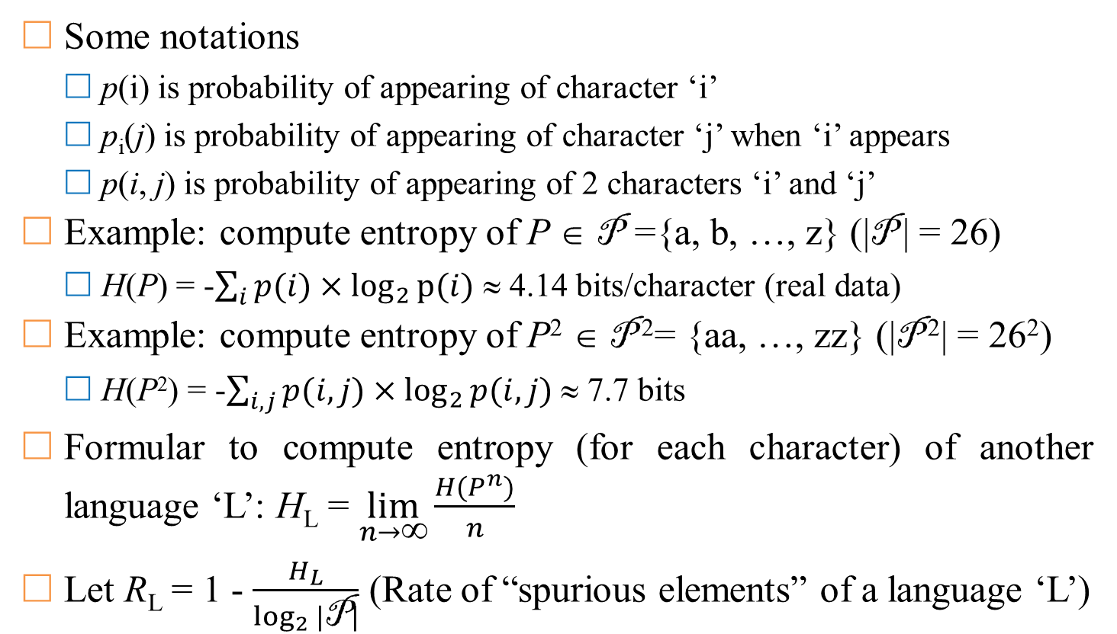
Language’s unicity distance
Some notations
  p(i) is probability of appearing of character ‘i’
  p_{i}(j) is probability of appearing of character ‘j’ when ‘i’ appears
  p(i, j) is probability of appearing of 2 characters ‘i’ and ‘j’
Example: compute entropy of P ∈ P ={a, b, …, z} (|P | = 26)
  H(P) = -$\sum_{i}{p(i)}×\log_{2}{p⁡(i)}$ ≈ 4.14 bits/character (real data)
Example: compute entropy of P² ∈ P ²= {aa, …, zz} (|P ²| = 26²)
  H(P²) = -$\sum_{i,j}{p(i,j)}×\log_{2}{p(i,j)}$ ≈ 7.7 bits
Formular to compute entropy (for each character) of another language ‘L’: H_{L} = $\lim_{n→∞}{\frac{H(P^{n})}{n}}$
Let R_{L} = 1 - $\frac{H_{L}}{\log_{2}{|\text{P}|}}$ (Rate of “spurious elements” of a language ‘L’)

Slide 26
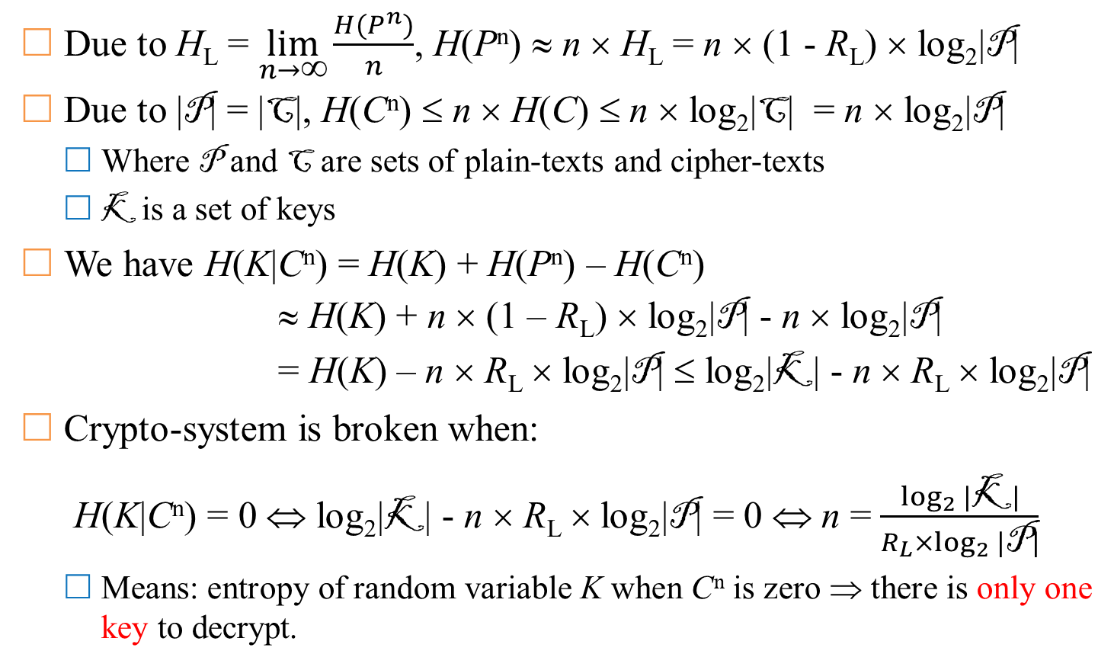
Language’s unicity distance
Due to H_{L} = $\lim_{n→∞}{\frac{H(P^{n})}{n}}$, H(P^{n}) ≈ n × H_{L} = n × (1 - R_{L}) × log₂|P|
Due to |P| = |C|, H(C^{n}) ≤ n × H(C) ≤ n × log₂|C| = n × log₂|P|
  Where P and C are sets of plain-texts and cipher-texts
  K is a set of keys
We have H(K|C^{n}) = H(K) + H(P^{n}) – H(C^{n})
≈ H(K) + n × (1 – R_{L}) × log₂|P| - n × log₂|P|
= H(K) – n × R_{L} × log₂|P| ≤ log₂|K| - n × R_{L} × log₂|P|
Crypto-system is broken when:
H(K|C^{n}) = 0 ⇔ log₂|K| - n × R_{L} × log₂|P| = 0 ⇔ n = $\frac{\log_{2}{|\text{K}|}}{R_{L}×\log_{2}{|\text{P}|}}$
  Means: entropy of random variable K when C^{n} is zero ⇒ there is only one key to decrypt.

Slide 27
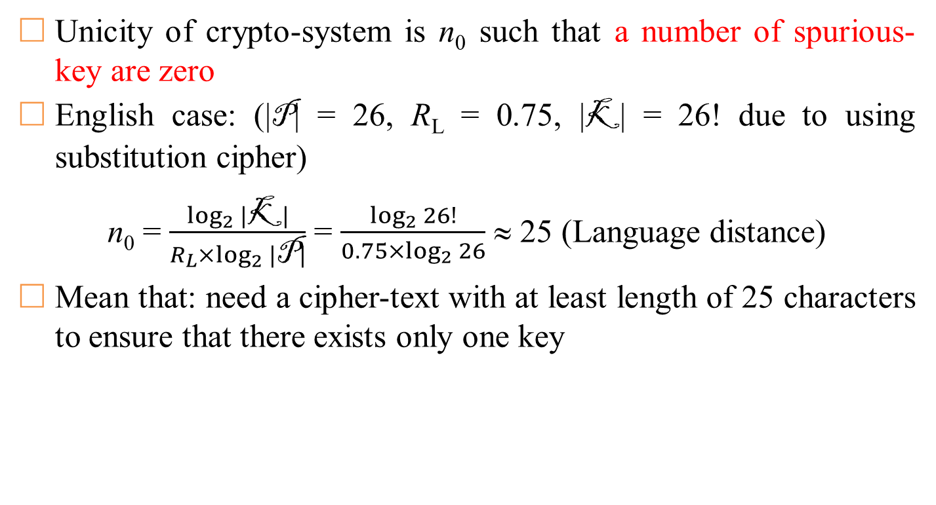
Language’s unicity distance
Unicity of crypto-system is n₀ such that a number of spurious-key are zero
English case: (|P| = 26, R_{L} = 0.75, |K| = 26! due to using substitution cipher)
n₀ = $\frac{\log_{2}{|\text{K}|}}{R_{L}×\log_{2}{|\text{P}|}}$ = $\frac{\log_{2}{26!}}{0.75×\log_{2}{26}}$ ≈ 25 (Language distance)
Mean that: need a cipher-text with at least length of 25 characters to ensure that there exists only one key

Slide 28
Comments
Data Compression
  Good compression – good encryption
  Good encryption – bad compression
Combination of encryption approaches
  “Weighted sum” of crypto-systems
    Create new crypto-systems from existing crypto-systems
    Choose 2 crypto-systems with the same message space, use system A with probability p, use system B with probability 1 – p.
  Product cipher: sequentially apply successive encryption algorithms

Slide 29
Introduction
Symmetric cryptosystem
  Conventional cryptosystem
  An encryption system in which the encryption and decryption processes both use the same key – secret key.
  The security of information depends on the security of the key.
Traditional methods use:
  Substitution: replace 1 word/character with another word/character
  Transposition: characters are changed their positions
Substitution/Transposition can be done with:
  Mono-alphabetic
  Poly-alphabetic

Slide 30




Symmetric cipher



Slide 31
Shift cipher
Shift Cipher:
  One of the oldest methods used for encryption
  The message is encrypted by rotating each character by k places in the alphabet
  The case with k = 3 is called the Caesar encryption method.
Let P = C = K = Z_{n}. For each k ∈ K we have:
  e_{k}(x) = x + k mod n and d_{k}(y) = y – k mod n, for x, y ∈ Z_{n}
  E = {e_{k}, k ∈ K} and D = {d_{k}, k ∈ K}
Properties:
  Simple
  Encryption and decryption processing is done quickly
  Key-space K = {0, 1, 2, …, n - 1} = Z_{n}
  Easily broken by trying every possible key

Slide 32
Shift cipher
Example: to encrypte a message represented by the letters A to Z (26 letters), we use Z₂₆.
  Encrypted messages are not secure and can be easily decrypted by trying one after another, 26 keys.
  On average, an encrypted message can be decrypted in about 26/2 = 13 tries.
Ciphertexts: JBCRCLQRWCRVNBJENBWRWN
Try k = 0, 1, 2, … 25
k = 0 | jbcrclqrwcrvnbjenbwrwn | k = 5 | ewxmxglmrxmqiweziwrmri
k = 1 | iabqbkpqvbqumaidmavqvm | k = 6 | dvwlwfklqwlphvdyhvqlqh
k = 2 | hzapajopuaptlzhclzupul | k = 7 | cuvkvejkpvkogucxgupkpg
k = 3 | gyzozinotzoskygbkytotk | k = 8 | btujudijoujnftbwftojof
k = 4 | fxynyhmnsynrjxfajxsnsj | k = 9 | astitchintimesavesnine

Slide 33
Substitution cipher
Substitution Cipher:
  Well-known and widely used encryption method for hundreds of years
  Encrypt the message by permuting the elements of the alphabet or, more generally, permuting the elements in the source set P.
Let P = C = Z_{n}, K are the sets of permutations of n elements 0, 1, …, n – 1. So, for each π ∈ K, a permutation of n elements 0, 1, …, n – 1. For each key π ∈ K, define:
  e_{π}(x) = π(x) and d_{π}(y) = π⁻¹(y), for x, y ∈ Z_{n}
  E = {e_{π}, π ∈ K} and D = {d_{π}, π ∈ K}
Properties:
  Simple, encryption and decryption are done quickly
  Key-space K has n! keys
  Overcoming the limitation of the Shift-Cipher method: It is impossible to attack by exhausting the key values ​​k ∈ K
Really secure???

Slide 34
Substitution cipher
AO VCO JO IBU RIBU
Attacks based on the occurrence of characters in the language
AO VCO JO IBU RIBU
?A H?A ?A ?NG ??NG
MA HOA VA UNG DUNG

Slide 35
Substitution cipher
Frequency analysis
  Character: E > T > R > N > I > O > A > S
  Digraph: TH > HE > IN > ER > RE > ON > AN > EN
  Trigraph: THE > AND > TIO > ATI > FOR > THA > TER > RES
L FDPH L VDZ L FRQTXHUHG
L FDPH L VDZ L FRQTXHUHG
i ?a?e i ?a? i ?????e?e?
i came i saw i conquered

Slide 36
Affine cipher
Let P = C = Z_{n}, K = {(a, b) ∈ Z_{n} × Z_{n}: gcd(a, n) = 1}. For each key k = (a, b) ∈ K, define:
  e_{k}(x) = (ax + b) mod n and d_{k}(y) = a⁻¹(y - b) mod n, for x, y ∈ Z_{n}
  E = {e_{k}, k ∈ K} and D = {d_{k}, k ∈ K}
For correct decrypt then e_{k} must be a bijection ⇒ gcd(a, n) = 1
Shift
Cipher
Substitution Cipher
Affine
Cipher

Slide 37
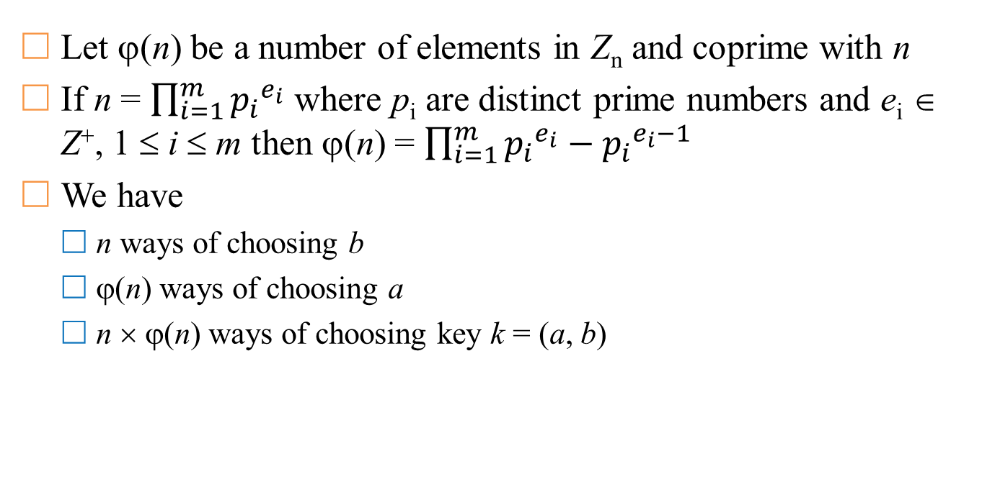
Affine cipher
Let ϕ(n) be a number of elements in Z_{n} and coprime with n
If n = $\prod_{i=1}^{m}{{p_{i}}^{e_{i}}}$ where p_{i} are distinct prime numbers and e_{i} ∈ Z⁺, 1 ≤ i ≤ m then ϕ(n) = $\prod_{i=1}^{m}{{p_{i}}^{e_{i}}}−{p_{i}}^{e_{i}−1}$
We have
  n ways of choosing b
  ϕ(n) ways of choosing a
  n × ϕ(n) ways of choosing key k = (a, b)

Slide 38
Euclide algorithm
Consider 2 prime numbers a and b (a > b) we have:
  a = q₀b + r₀ (0 < r₀ < b)
  b = q₁r₀ + r₁ (0 < r₁ < r₀)
  r₀ = q₂r₁ + r₂ (0 < r₂ < r₁)
  r₁ = q₃r₂ + r₃ (0 < r₃ < r₂)
  …
  r_{m-2} = q_{m-1}r_{m-1} + r_{m} (0 < r_{m} < r_{m-1})
  r_{m-1} = q_{m}r_{m} (0 = r_{m+1} < r_{m})
Easily see:
  gcd(a, b) = gcd(b, r₀) = gcd(r₀, r₁) = … = gcd(r_{m-1}, r_{m}) = r_{m}.
  Example: gcd(1071, 462) = gcd(462, 147) = gcd(147, 21) = 21
https://en.wikipedia.org/wiki/Euclidean_algorithm

Slide 39
Vigenere cipher
Choose a positive integer m. Let P = C = K = (Z_{n})^{m}.
  K = {(k₁, k₂, …, k_{m}) ∈ (Z_{n})^{m}}
  For each key k = (k₁, k₂, …, k_{m}) ∈ K and ∀x, y ∈ (Z_{n})^{m}, define:
    e_{k}(x₁, x₂, …, x_{m}) = ((x₁ + k₁) mod n, (x₂ + k₂) mod n, …, (x_{m} + k_{m}) mod n)
    d_{k}(y₁, y₂, …, y_{m}) = ((y₁ - k₁) mod n, (y₂ - k₂) mod n, …, (y_{m} - k_{m}) mod n)
Subtitution cipher: for each key k, plain-text x ∈ P is mapped to only one y ∈C.
Vigenere cipher uses key with length m.
  Named after Blaise de Vigenere (Century 16)
  The Vigenere cipher can be viewed as consisting of m displacement ciphers that are applied alternately on a periodic basis.
  Key-space K of Vigenere cipher is n^{m}
  For example: n = 26, m = 5 then key-space has ~1.1 × 10⁷ keys

Slide 40
Vigenere cipher
Example: m = 6 and keyword CIPHER
Then, key k = (2, 8, 15, 7, 4, 17)
Let plaintexts: thiscryptosystemisnotsecure
t
h
i
s
c
r
y
p
t
o
s
y
s
t
e
m
i
s
19 | 7 | 8 | 18 | 2 | 17
2 | 8 | 15 | 7 | 4 | 17
21 | 15 | 23 | 25 | 6 | 8
24 | 15 | 19 | 14 | 18 | 24
2 | 8 | 15 | 7 | 4 | 17
0 | 23 | 8 | 21 | 22 | 15
18 | 19 | 4 | 12 | 8 | 18
2 | 8 | 15 | 7 | 4 | 17
20 | 1 | 19 | 19 | 12 | 9
n
o
t
s
e
c
u
r
e
13 | 14 | 19 | 18 | 4 | 2
2 | 8 | 15 | 7 | 4 | 17
15 | 22 | 8 | 25 | 8 | 19
20 | 17 | 4
2 | 8 | 15
22 | 25 | 19

Slide 41
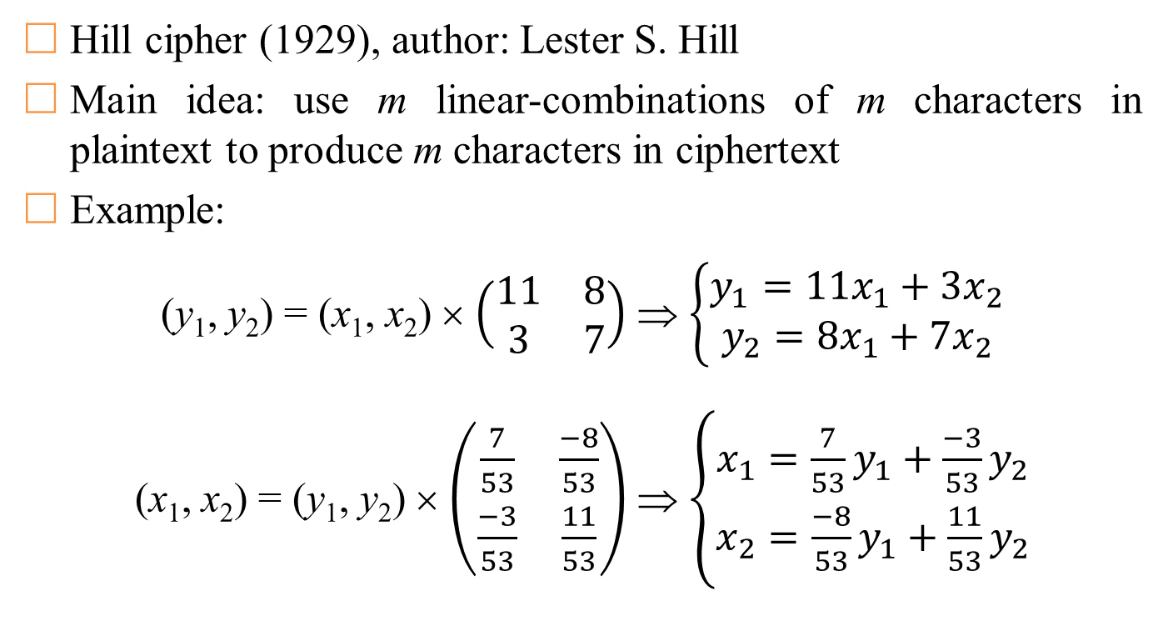
Hill cipher
Hill cipher (1929), author: Lester S. Hill
Main idea: use m linear-combinations of m characters in plaintext to produce m characters in ciphertext
Example:
(y₁, y₂) = (x₁, x₂) × $\left(\begin{matrix}11 & 8 \\ 3 & 7\end{matrix}\right)$ ⇒ $\left\{\begin{aligned}y_{1}=11x_{1}+3x_{2} \\ y_{2}=8x_{1}+7x_{2}\end{aligned}\right.$
(x₁, x₂) = (y₁, y₂) × $\left(\begin{matrix}\frac{7}{53} & \frac{−8}{53} \\ \frac{−3}{53} & \frac{11}{53}\end{matrix}\right)$ ⇒ $\left\{\begin{aligned}x_{1}=\frac{7}{53}y_{1}+\frac{−3}{53}y_{2} \\ x_{2}=\frac{−8}{53}y_{1}+\frac{11}{53}y_{2}\end{aligned}\right.$

Slide 42
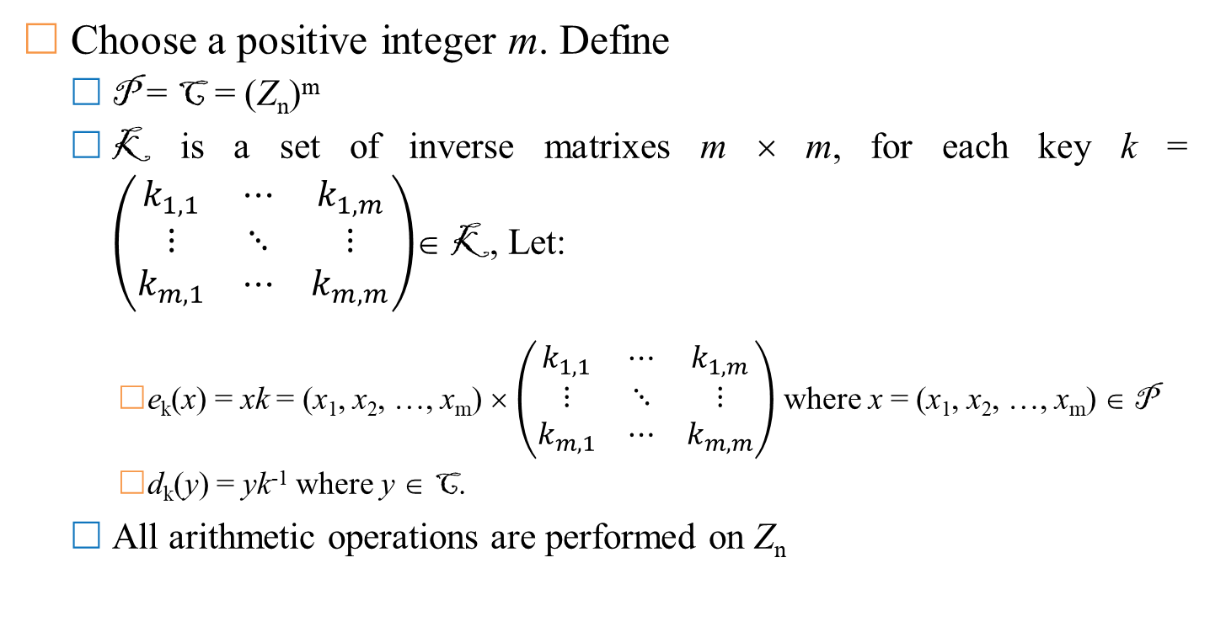
Hill cipher
Choose a positive integer m. Define
  P = C = (Z_{n})^{m}
  K is a set of inverse matrixes m × m, for each key k = $\left(\begin{matrix}k_{1,1} & ⋯ & k_{1,m} \\ ⋮ & ⋱ & ⋮ \\ k_{m,1} & ⋯ & k_{m,m}\end{matrix}\right)$∈ K, Let:
    e_{k}(x) = xk = (x₁, x₂, …, x_{m}) × $\left(\begin{matrix}k_{1,1} & ⋯ & k_{1,m} \\ ⋮ & ⋱ & ⋮ \\ k_{m,1} & ⋯ & k_{m,m}\end{matrix}\right)$ where x = (x₁, x₂, …, x_{m}) ∈ P
    d_{k}(y) = yk⁻¹ where y ∈ C.
  All arithmetic operations are performed on Z_{n}

Slide 43
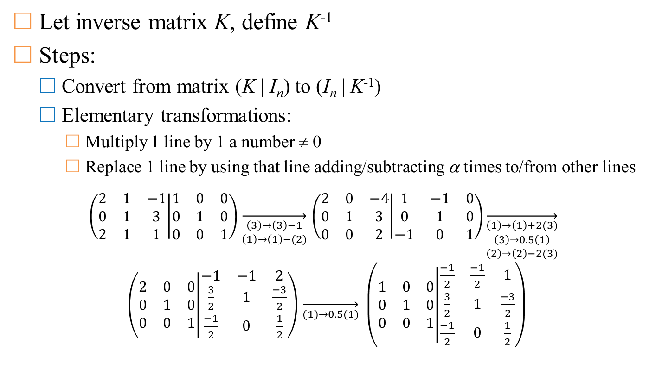
Inverse matrix
Let inverse matrix K, define K⁻¹
Steps:
  Convert from matrix (K | I_{n}) to (I_{n} | K⁻¹)
  Elementary transformations:
    Multiply 1 line by 1 a number ≠ 0
    Replace 1 line by using that line adding/subtracting α times to/from other lines
$\left(\begin{matrix}2 & 1 & −1 \\ 0 & 1 & 3 \\ 2 & 1 & 1\end{matrix} | \begin{matrix}1 & 0 & 0 \\ 0 & 1 & 0 \\ 0 & 0 & 1\end{matrix}\right)$ $\overset{→}{\begin{aligned}\left(3\right)→\left(3\right)−1 \\ \left(1\right)→\left(1\right)−(2)\end{aligned}}$ $\left(\begin{matrix}2 & 0 & −4 \\ 0 & 1 & 3 \\ 0 & 0 & 2\end{matrix} | \begin{matrix}1 & −1 & 0 \\ 0 & 1 & 0 \\ −1 & 0 & 1\end{matrix}\right)\overset{→}{\begin{aligned}\left(1\right)→\left(1\right)+2(3) \\ \left(3\right)→0.5\left(1\right) \\ \left(2\right)→\left(2\right)−2(3)\end{aligned}} \left(\begin{matrix}2 & 0 & 0 \\ 0 & 1 & 0 \\ 0 & 0 & 1\end{matrix} | \begin{matrix}−1 & −1 & 2 \\ \frac{3}{2} & 1 & \frac{−3}{2} \\ \frac{−1}{2} & 0 & \frac{1}{2}\end{matrix}\right)$ $\overset{→}{(1)→0.5(1)} \left(\begin{matrix}1 & 0 & 0 \\ 0 & 1 & 0 \\ 0 & 0 & 1\end{matrix} | \begin{matrix}\frac{−1}{2} & \frac{−1}{2} & 1 \\ \frac{3}{2} & 1 & \frac{−3}{2} \\ \frac{−1}{2} & 0 & \frac{1}{2}\end{matrix}\right)$

Slide 44
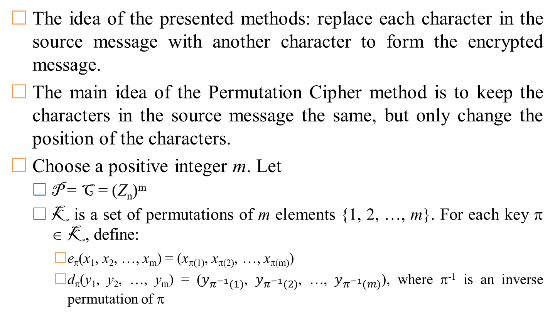
Permutation cipher
The idea of ​​the presented methods: replace each character in the source message with another character to form the encrypted message.
The main idea of ​​the Permutation Cipher method is to keep the characters in the source message the same, but only change the position of the characters.
Choose a positive integer m. Let
  P = C = (Z_{n})^{m}
  K is a set of permutations of m elements {1, 2, …, m}. For each key π ∈ K, define:
    e_{π}(x₁, x₂, …, x_{m}) = (x_{π(1)}, x_{π(2)}, …, x_{π(m)})
    d_{π}(y₁, y₂, …, y_{m}) = ($y_{π^{−1}(1)}$, $y_{π^{−1}(2)}$, …, $y_{π^{−1}(m)}$), where π⁻¹ is an inverse permutation of π

Slide 45
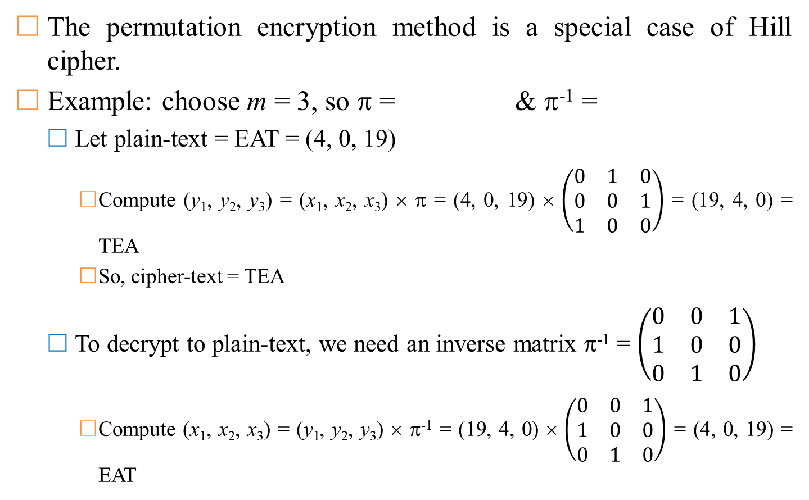
Permutation cipher
The permutation encryption method is a special case of Hill cipher.
Example: choose m = 3, so π = & π⁻¹ =
  Let plain-text = EAT = (4, 0, 19)
    Compute (y₁, y₂, y₃) = (x₁, x₂, x₃) × π = (4, 0, 19) × $\left(\begin{matrix}0 & 1 & 0 \\ 0 & 0 & 1 \\ 1 & 0 & 0\end{matrix}\right)$ = (19, 4, 0) = TEA
    So, cipher-text = TEA
  To decrypt to plain-text, we need an inverse matrix π⁻¹ = $\left(\begin{matrix}0 & 0 & 1 \\ 1 & 0 & 0 \\ 0 & 1 & 0\end{matrix}\right)$
    Compute (x₁, x₂, x₃) = (y₁, y₂, y₃) × π⁻¹ = (19, 4, 0) × $\left(\begin{matrix}0 & 0 & 1 \\ 1 & 0 & 0 \\ 0 & 1 & 0\end{matrix}\right)$ = (4, 0, 19) = EAT
1 | 2 | 3
3 | 1 | 2
1 | 2 | 3
2 | 3 | 1

Slide 46
Permutation cipher
Example: choose m = 6
  So π = & π⁻¹ =
  Assume plain-texts = shesellsseashellsbytheseashore
  So, cipher-texts = eeslshsalseslshblehsyeethraeos
1 | 2 | 3 | 4 | 5 | 6
3 | 5 | 1 | 6 | 4 | 2
1 | 2 | 3 | 4 | 5 | 6
3 | 6 | 1 | 5 | 2 | 4
s | h | e | s | e | l
e | e | s | l | s | h
l | s | s | e | a | s
s | a | l | s | e | s
h | e | l | l | s | b
l | s | h | b | l | e
y | t | h | e | s | e
h | s | y | e | e | t
a | s | h | o | r | e
h | r | a | e | o | s

